Slide 1

Integrating Smart GenAI Chatbot with Google Chat using REST API and AI Model’s
Ankith
Karthik
Sweety
Bhavya

Slide 2
Problem Statement
The project aims to integrate a chatbot, Smart GenAI, with Google Chat using a REST API.
Challenges include efficiently managing requests between Google Chat, the REST API, and the chatbots .
The goal is to provide users with an intelligent conversation interface integrated within Google Chat.

Slide 3
Technical Stack
Backend Framework: FastAPI
API Server: Uvicorn
Model Integration: OpenAI GPT ,Google Gemini, Llama
Data Validation: Pydantic
Deployment: Python environment (pip)
Testing Tool: Postman
Database: Optional (PostgreSQL or MongoDB)
Authentication: Optional (OAuth 2.0)
Hosting: Google cloud Platform
Version Control: Git

Slide 4
Project Architecture
Chatbot
API
Google Chat Integration

Slide 5
1. A user initiates a message in Google Chat.
2. Google Chat forwards the message to the designated REST API endpoint.
3. The API receives the message and extracts relevant information.
4. The API processes the message, preparing it for interaction with the AI model.
5. The API communicates with the AI model using the provided input.
6. The AI model generates a response based on the user’s message.
7. The API receives the response from the AI model.
8. The API formats the response for proper presentation in Google Chat.
9. The formatted response is sent back to Google Chat through the API.
10. The user sees the AI-generated response in the Google Chat interface.

Slide 6
Use of Technical Stack
Backend Framework (FastAPI): Fast web framework for building APIs in Python.
API Server (Uvicorn): ASGI server for running FastAPI applications efficiently.
Model Integration (OpenAI GPT, Google Gemini, Llama): Integrates AI models for natural language processing.
Data Validation (Pydantic): Validates and manages data with Python type annotations.
Deployment (Python with pip): Manages dependencies and deploys applications consistently.
Testing Tool (Postman): Tests API endpoints and inspects responses easily.
Database (PostgreSQL or MongoDB): Stores data with relational (PostgreSQL) or NoSQL (MongoDB) options.
Authentication (OAuth 2.0): Secures user authentication and authorization for applications.
Hosting (Google Cloud Platform): Provides scalable cloud infrastructure for application deployment.
Version Control (Git): Tracks code changes and facilitates collaboration.

Slide 7
Development Process
Python.eve
Install Dependencies
Create API(Rest,Fast,Uvicorn)
Integrate AI Models
Configure Google Chat
Integrate API
Test the flow (Postman)
Debug
Deploy & Finalize the Integration

Slide 8
Challenges Faced
API Rate Limits: Manage usage limits set by AI providers to prevent disruptions.
Latency Issues: Reduce response time between Google Chat and the API.
Scaling the Application: Ensure efficiency in handling increased user loads during peak times.
Security Concerns: Safeguard user data and secure communications between services.
Error Handling and Logging: Implement effective error management and logging for better debugging.
User Authentication and Authorization: Secure user identity and maintain privacy during integration.
Managing State: Keep track of conversation states across user interactions.
Testing AI Responses: Validate that AI provides accurate and relevant responses.
Updating Dependencies: Monitor library updates to maintain compatibility and stability.
Documentation and Maintenance: Provide clear documentation and ensure code maintainability as the project evolves.

Slide 9
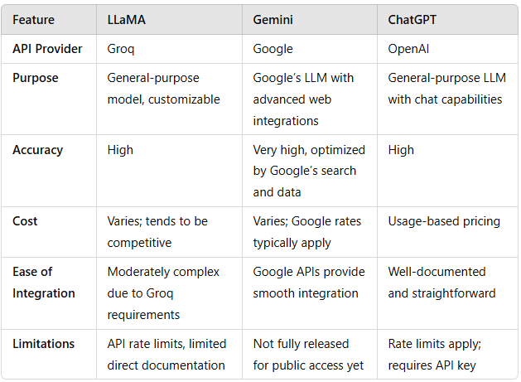
Comparing AI Models :

Slide 10
Pros and Cons of Each Model in the API Context
LLaMA (Groq)
Pros: High customization, potential for unique tuning for network issues.
Cons: Moderate complexity, Groq integration may require specific setup.
Gemini (Google)
Pros: Likely to be highly reliable and accurate due to Google’s dataset.
Cons: Access is currently limited, and costs may be higher.
ChatGPT (OpenAI)
Pros: Easy to integrate with clear documentation, extensive general-purpose use.
Cons: Limited to OpenAI’s chat-based responses, rate limits, can be expensive for high usage.

Slide 11
Key Challenges – AI Models
API Key Management: Each AI service requires an API key, and mismanagement can lead to unauthorized access or rate-limit issues.
Error Handling: Integrating multiple AI services requires robust error handling in case an AI model fails.
Rate Limits: High traffic can lead to reaching usage limits on AI services, which impacts response times.

Slide 12
Dependencies and Evaluation
Dependencies: Python packages (fastapi, pydantic, uvicorn, transformers, torch)
Evaluation:
1. Successful integration between Google Chat and LLaMA 3.
2. Proper message handling by the API.
3. Postman tests for API responses.

Slide 13
Cost Estimation
Infrastructure Costs
Cloud Hosting: $10 - $60 / ₹830 - ₹4,995
API Gateway: $3.50/million requests / ₹290/million requests
Database: $15 - $50 / ₹1,245 - ₹4,150
Storage: ~$0.023/GB / ~₹1.91/GB
AI Model Usage Costs
LLaMA (Groq): $0.01 - $0.03 / ₹0.83 - ₹2.49 per 1,000 tokens
Google Gemini: ~$0.01 - $0.20 / ~₹0.83 - ₹16.60
ChatGPT: $2,000 - $30,000 / ₹165,000 - ₹2,485,000
Other Costs
Maintenance: 15-20% of total development costs/year

Slide 14
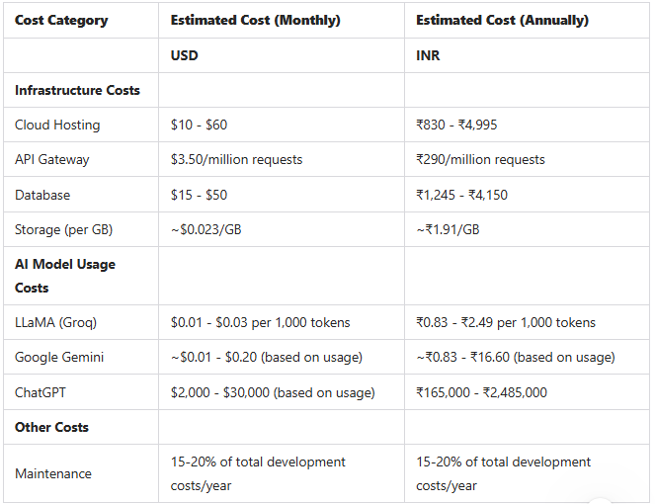

Slide 15
Conclusion
Model Choice: We are utilizing LLaMA 3.1 for its:
Best time complexity.(Averge time :651ms , tokens : 1200)
Efficient answering capabilities.(98%)
Implementation Benefits:
Easy to integrate into the chatbot (Smart GenAI).
Low operational costs, making it budget-friendly.
Future Enhancements:
Plans to improve response times.
Exploration of additional AI capabilities.
Overall Impact: Enhances communication and productivity on platforms like Google Chat.

